Slide 1

Go, change the world
RV College of
Engineering
VGGNet
Niranjan G C
1RV23SCS05

Slide 2
VGGNet
(Unit 5)

Slide 3
INDEX
Introduction
Architecture
Significance
Limitations

Slide 4
Introduction
VGGNet It is a typical deep Convolutional Neural Network (CNN) design with numerous layers
VGG stands for Visual Geometry Group.
2 types of ConvNet architectures developed by VGG
VGG 16
VGG 19

Slide 5
The numbers “16” and “19” refer to the model’s weight layers.
The VGG19 architecture has the same basic idea as that of VGG16 model, with the exception that it supports 19 layers.
In comparison to VGG16, VGG19 contains three extra convolutional layers.

Slide 6
ARCHITECTURE: VGG 16
13 x Convolutional Layers (ReLU activation)
5 x Pooling Layers (Max Pooling)
3 x Fully Connected Layers ( 2 Hidden Layers ReLU activated; 1 output layer Softmax activated)

Slide 7
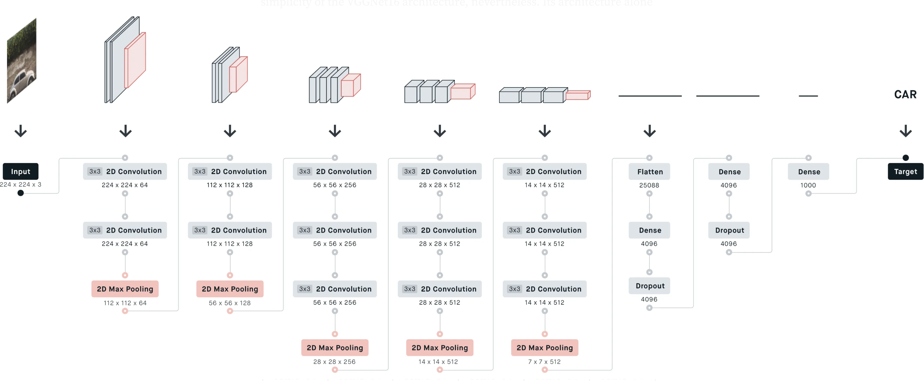
architecture

Slide 8
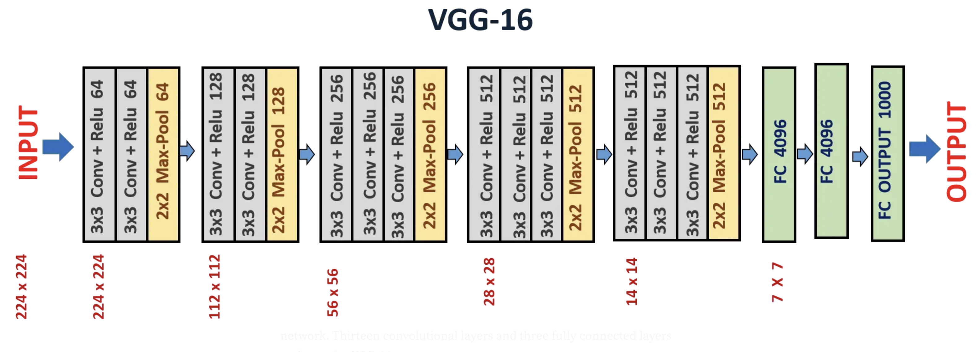

Slide 9
Input: 224 x 224 x 3 dimensional image.
Convolutional Layers: All of VGG's convolutional layers use
3 x 3 filters
Padding p = 1
Stride s = 1 pixel
ReLU activation

Slide 10
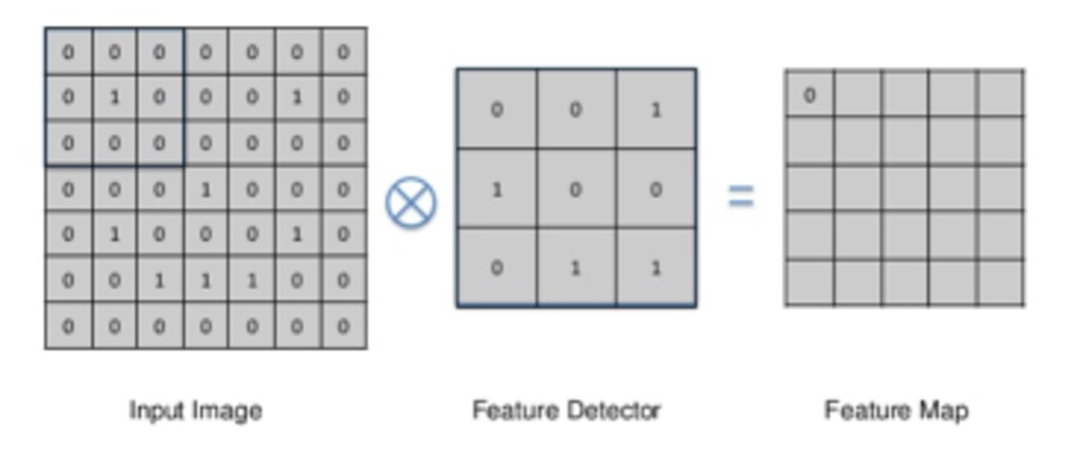
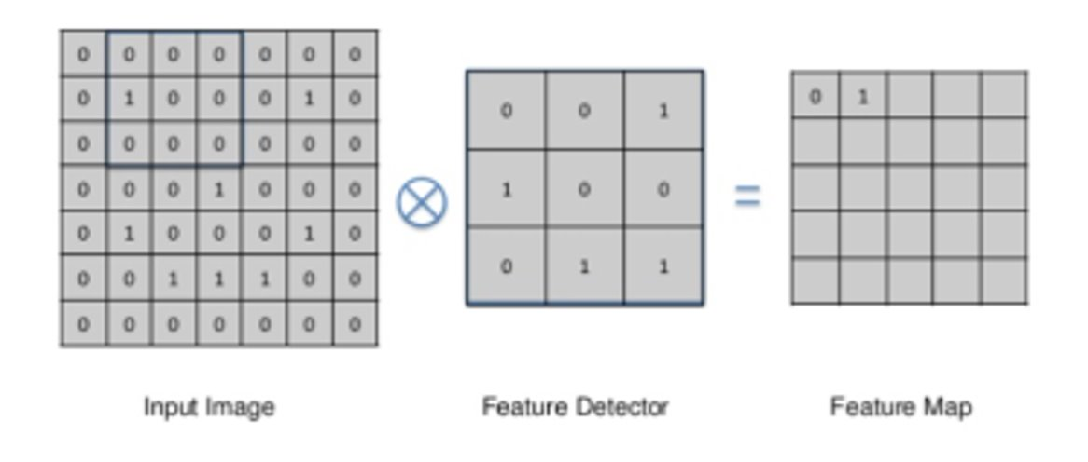

Slide 11
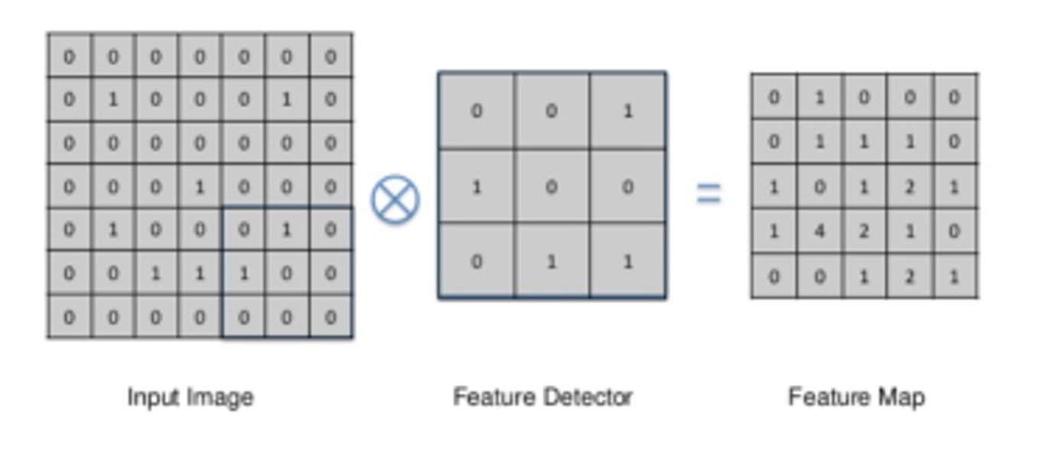
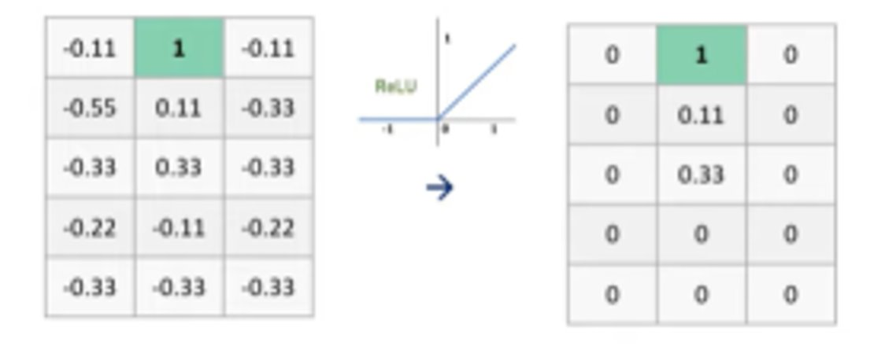

Slide 13
Pooling Layers: All of VGG's pooling layers use max-pooling with 2 x 2 filters and stride s = 2 pixels
Fully Connected Layers: The VGGNet contains three layers with full connectivity. The first two layers (hidden) each have 4096 nodes (ReLU activated), while the third layer has 1000 nodes (Softmax activated) with one node for each class.

Slide 14
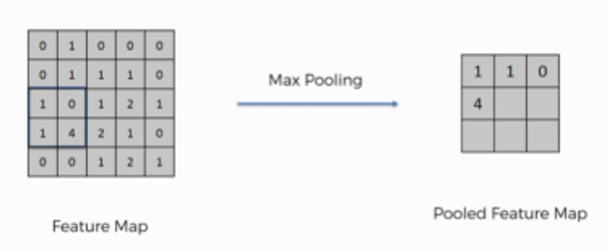
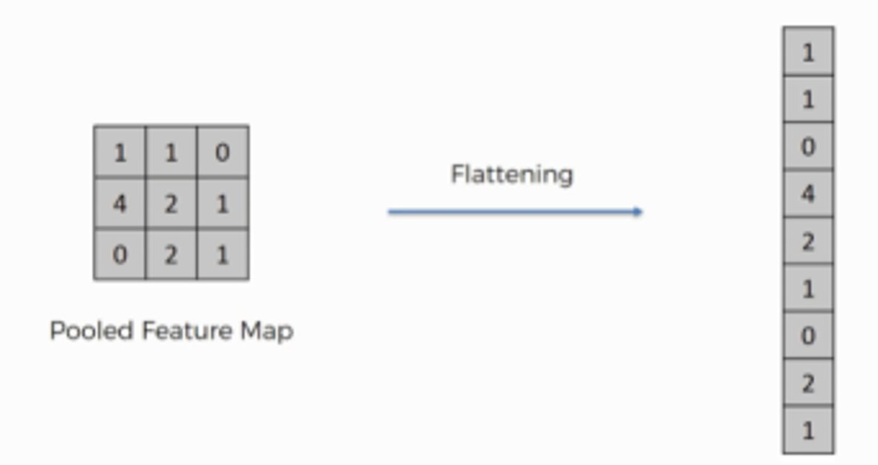

Slide 15
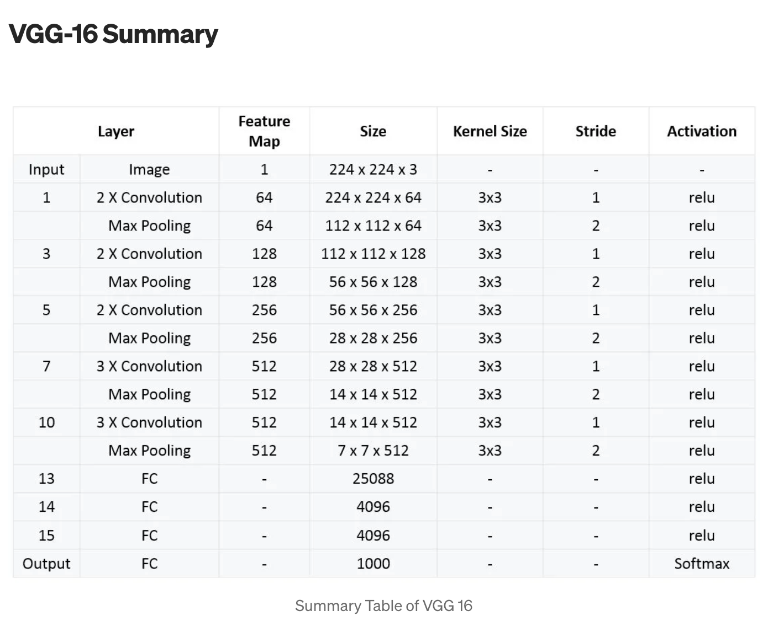

Slide 16
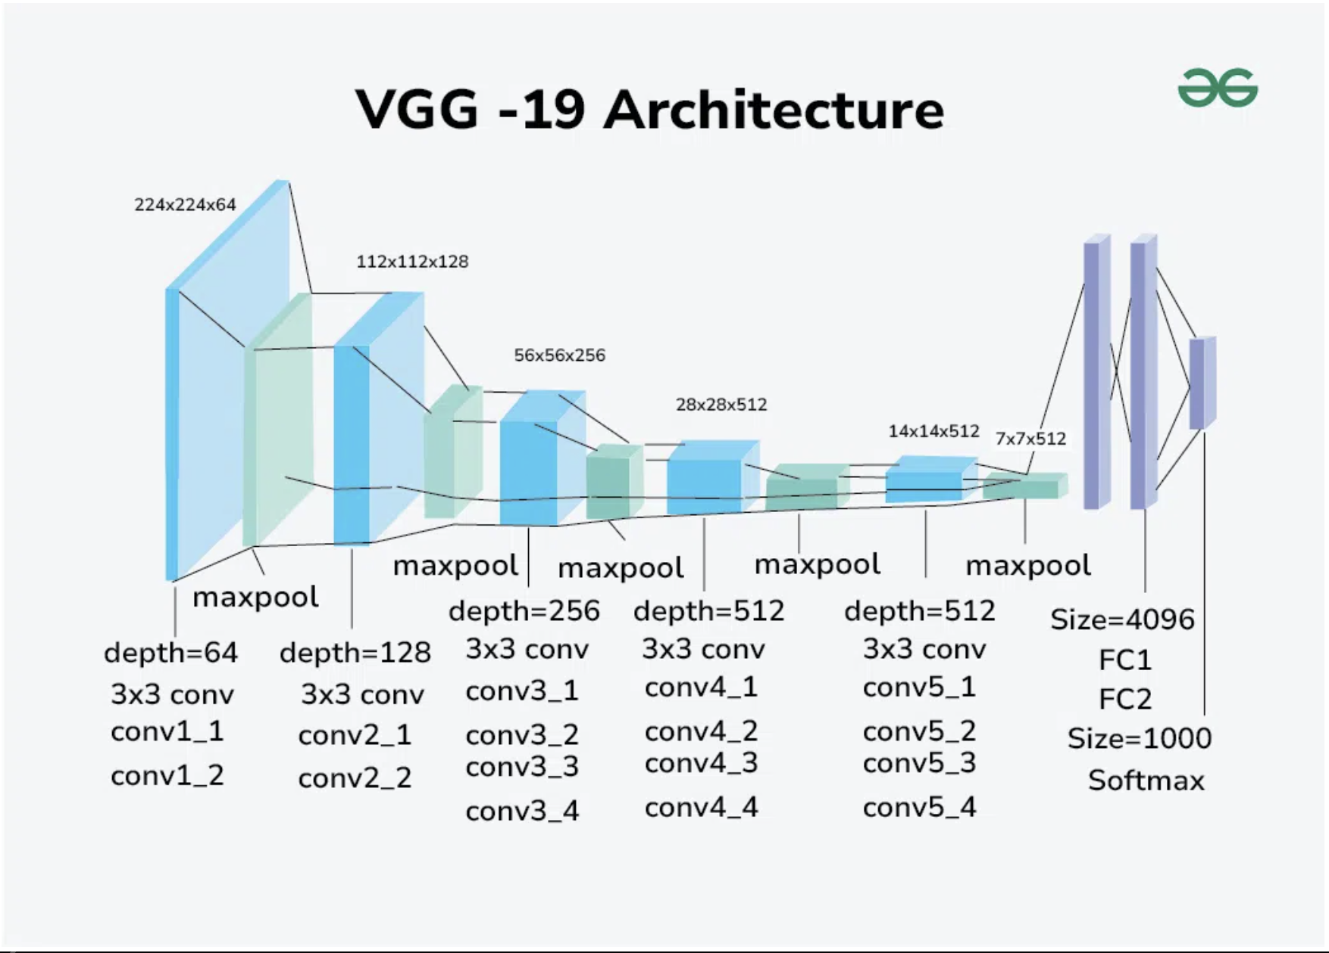

Slide 17
significance
VGGNet is pre-trained on the ImageNet dataset (a large-scale dataset containing over 14 million images belonging to 1000 different classes)
In ImageNet, the VGG16 model achieved a top-5 test accuracy of about 92.7 per cent.
It was also among the most well-liked models submitted at ILSVRC-2014 because of the uniformity and simplicity of the architecture.

Slide 18
Transfer Learning: VGGNet is commonly used in transfer learning due to its depth and performance on various image classification tasks.

Slide 19
Limitations
It is very slow to train (the original VGG model was trained on Nvidia Titan GPU for 2–3 weeks).
The size of VGG-16 trained imageNet weights is 528 MB. So, it takes quite a lot of disk space and bandwidth which makes it inefficient.
138 million parameters lead to exploding gradients problem.

Slide 20
THANK YOU

